Slide 1
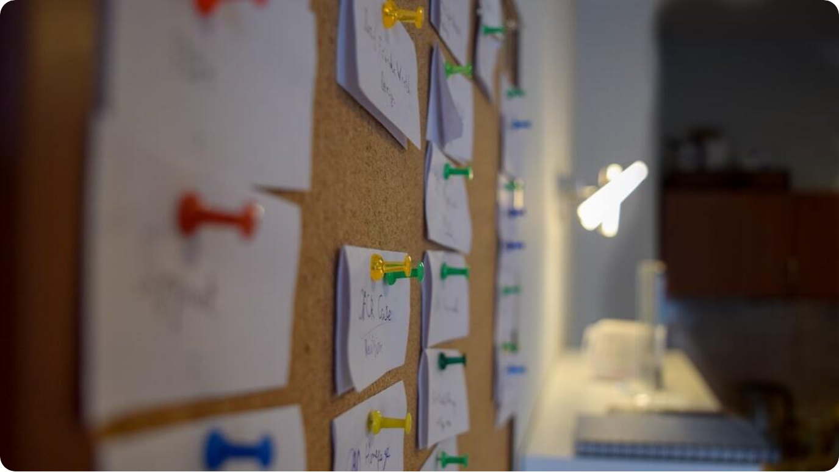
Introduction to the AEIS RAG Application
Building Intelligent Search and Response Systems with Azure & Vector Databases
Purpose of the Application: The Retrieval-Augmented Generation (RAG) application enhances document-based information retrieval and response generation using Azure AI and vector databases.
  Core Workflow: Documents are ingested, processed by Azure Document Intelligence, embedded into a vector database, and queried semantically to provide contextual LLM responses.
  Key Technologies: Azure Document Intelligence, PostgreSQL with vector extensions, text embedding models, OpenAI LLMs, and Angular frontend integration.
  End-User Experience: Users interact through an Angular app that allows querying documents and receiving intelligent, context-aware responses in real time.
Notes:
This project implements a complete Retrieval-Augmented Generation system designed for efficient document processing and intelligent query answering. We start with a high-level view of how the application connects data ingestion, embedding, search, and generation.
The primary goal is to empower users to retrieve precise, contextually relevant information from large document repositories. Azure Document Intelligence plays a crucial role by extracting structured data and metadata before we embed text representations into a PostgreSQL vector database.
The frontend is built in Angular, ensuring a smooth and responsive interface for users to submit queries and receive intelligent responses powered by an LLM. The following slides will explore each part of this architecture in more detail.

Slide 2
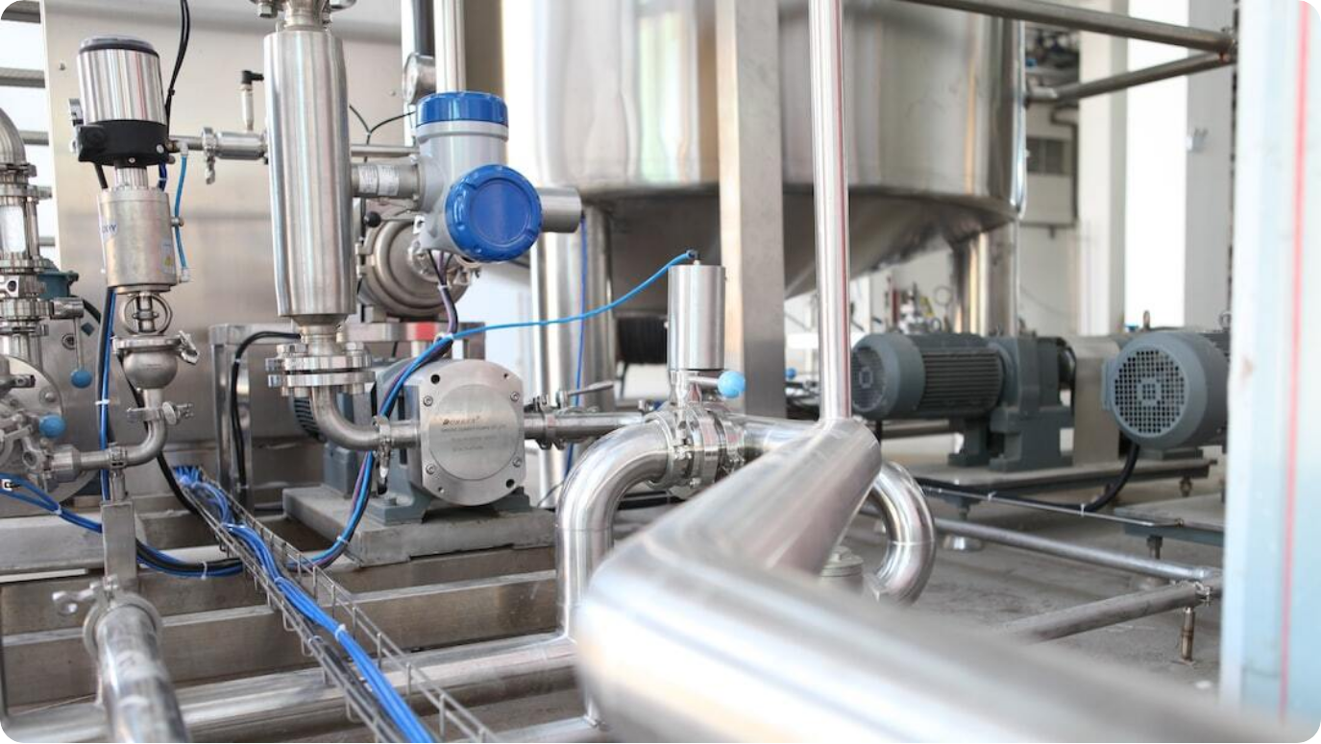
Document Ingestion Pipeline
Transforming Raw Files into Searchable Knowledge
Document Upload and Intake: Users or systems upload raw documents—PDFs, Word files, scanned images—which serve as the knowledge base for the RAG system.
  Preprocessing and Formatting: Each document is cleaned, standardized, and converted into a structured format that enables consistent downstream processing.
  Metadata Enrichment: Key attributes such as document title, author, date, and category are extracted and stored to support intelligent filtering and retrieval.
  Integration with Azure Document Intelligence: Documents are securely sent to Azure Document Intelligence for deep data extraction and analysis of content, layout, and context.
Notes:
The ingestion pipeline is the foundation of the RAG system—it’s how raw, unstructured data becomes usable intelligence. Think of it as the 'plumbing' that ensures data flows cleanly into your knowledge engine.
Documents from different sources—whether scanned contracts, reports, or PDFs—are uploaded into the system. These files go through preprocessing to clean text and normalize formats so that they’re ready for analysis.
Azure Document Intelligence is the star here: it reads and understands documents like a human analyst would, identifying fields, tables, and relationships. The output isn’t just text—it’s data enriched with metadata, ready for embedding and retrieval.

Slide 3

Azure Document Intelligence Extraction
Teaching Machines to Read, Understand, and Structure Documents
AI-Powered Understanding: Azure Document Intelligence uses pre-trained AI models to interpret documents just like a human reader—detecting layout, tables, handwriting, and contextual relationships.
  Structured Data Extraction: Instead of raw text, it extracts key-value pairs, entities, and metadata, converting unstructured files into usable, structured information.
  Support for Complex Formats: From invoices and contracts to scanned images, it handles diverse document types through form recognizers and custom models.
  Bridge to the RAG Pipeline: The extracted data and metadata become the input for the embedding stage—ensuring that only meaningful information enters the vector database.
Notes:
Azure Document Intelligence is the brain that makes the ingestion pipeline smart. Think of it as the 'Mario power-up' moment—where plain documents transform into structured, AI-readable data.
Using advanced vision and language models, it identifies text blocks, tables, and semantic structure in complex files. Whether it's a scanned contract or a detailed report, the system captures key information accurately.
This stage ensures that what goes into your RAG pipeline isn't just text, but high-quality, semantically rich data. It’s the crucial bridge between raw input and meaningful retrieval later in the workflow.

Slide 4

Embedding Generation and Vector Storage
Turning Knowledge into Searchable Mathematical Representations
Creating Embeddings: Text embedding models convert document content into high-dimensional vectors—numerical fingerprints that capture meaning and context.
  Semantic Representation: Similar meanings produce similar vectors, allowing the system to compare concepts beyond exact word matches.
  PostgreSQL Vector Database: The embeddings are stored in a PostgreSQL vector database, enabling efficient semantic search through vector similarity queries.
  Foundation for Retrieval: This step is the backbone of RAG—allowing queries to locate relevant chunks of knowledge based on semantic proximity, not keyword overlap.
Notes:
In this stage, raw intelligence transforms into mathematics. Each sentence or paragraph becomes a vector—a long list of numbers that encode its meaning. Imagine compressing the essence of a paragraph into coordinates on a multidimensional map.
Using powerful embedding models, we create representations where similar ideas cluster together. This allows the system to find 'conceptual neighbors' instead of just matching keywords.
PostgreSQL’s vector capabilities make it possible to perform lightning-fast similarity searches. The result? A database that understands context, not just text—a vital building block for meaningful AI retrieval.

Slide 5


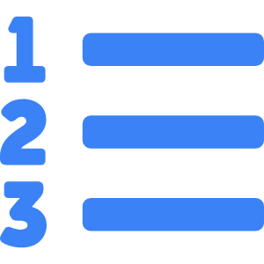

Query Workflow and Semantic Search
Finding Meaning, Not Just Keywords
User Query Processing
When a user asks a question, the system converts it into an embedding vector—representing its semantic meaning.
Vector Similarity Search
The query vector is compared against stored document vectors in the PostgreSQL database using cosine similarity to find the most related content.
Top Results Retrieval
The top five most semantically similar document chunks are fetched as evidence for the LLM to use in generating a precise answer.
Contextual Accuracy
This process ensures responses are contextually grounded, minimizing hallucinations and improving factual accuracy.
Notes:
Here’s where the magic of RAG truly shines. When a user submits a query, we don’t look for keyword matches—we look for meaning. The system translates the question into a vector, just like we did for our documents.
It then searches the vector database using similarity metrics—essentially asking: *which pieces of stored knowledge are closest in meaning to this question?* This results in the top five most relevant document chunks.
By working on a conceptual level, not just a textual one, the RAG pipeline retrieves insights that truly understand user intent. This is what makes semantic search so powerful and why it’s central to modern AI-driven knowledge systems.

Slide 6




LLM Response Generation
Crafting Intelligent, Context-Aware Answers
Feeding Context to the LLM
The top retrieved chunks from the vector database are combined with the user’s query and passed as context to the Large Language Model (LLM).
Contextual Reasoning
The LLM analyzes both the query and retrieved data, generating coherent, evidence-based responses grounded in the original documents.
Minimizing Hallucinations
By grounding responses in verified document chunks, the model avoids making unsupported claims and stays aligned with real data.
Adaptive Communication
The response is phrased naturally for users—summarizing, explaining, or detailing information depending on the intent and query type.
Notes:
This is where your RAG system truly comes to life. Once the top five relevant document chunks are identified, they’re fed into the Large Language Model alongside the user’s query.
The LLM acts like a brilliant assistant—it doesn’t just retrieve; it reasons. It interprets the query, reads the supporting material, and constructs a fluent, evidence-backed answer. Because the knowledge is grounded in real documents, it drastically reduces the risk of hallucination.
The result is a response that’s not only intelligent but also trustworthy. Whether the user asks for summaries, explanations, or deep insights, the model adapts dynamically—delivering answers that make sense and build confidence in AI-assisted search.

Slide 7

Frontend Integration: Angular App
Bringing AI-Powered Knowledge Retrieval to Users
Interactive User Experience: The Angular frontend provides a sleek and responsive chat-like interface where users can ask questions and view AI-generated answers.
  Real-Time Communication: Queries are sent via APIs to the RAG backend, which processes and returns responses almost instantly for a seamless user experience.
  Visualizing Context: Results can include highlighted text, source document links, and visual summaries, giving users transparency into where answers come from.
  Scalable Web Architecture: Built with Angular’s modular framework, the interface can easily integrate new AI features or connect with Azure services for enterprise scalability.
Notes:
The frontend is where your users meet the power of AI. Built in Angular, it delivers a clean and intuitive experience—allowing anyone to query vast document repositories naturally.
When a user asks a question, the app communicates with the backend in real time. The RAG system retrieves, reasons, and responds in seconds, with the frontend displaying results conversationally, much like a smart chat assistant.
By surfacing contextual data and linking responses to their source documents, users gain confidence in the AI’s transparency. And because Angular is modular, the platform can evolve—adding dashboards, analytics, or new Azure AI integrations without disruption.

Slide 8
End-to-End System Architecture
From Document to Intelligent Answer
1. Document Ingestion: Documents are uploaded and processed through Azure Document Intelligence to extract data and metadata.
  2. Embedding & Storage: Text embedding models generate vector representations stored in PostgreSQL for efficient semantic search.
  3. Semantic Retrieval: User queries are embedded and compared to stored vectors, retrieving the top five most semantically relevant chunks.
  4. LLM Response Generation: Retrieved chunks feed the Large Language Model to generate context-aware, grounded responses.
  5. Angular Frontend: Responses are delivered to the user via a real-time, interactive Angular application interface.
Notes:
Here’s how the entire RAG pipeline connects—from raw data to real-time insights. Each component plays a unique role, but together they form a seamless AI ecosystem.
Documents begin their journey through Azure Document Intelligence, where they’re decoded into structured information. That information is transformed into embeddings and stored in PostgreSQL for semantic search.
When a user interacts through the Angular frontend, their question triggers a cascade: embedding, retrieval, reasoning, and response—all happening in seconds. The architecture’s modular design means you can swap models, scale databases, or add features without breaking the flow.

Slide 9

Future Enhancements & Acknowledgement
Scaling Intelligence and Expressing Gratitude
Notes:
As we look ahead, the RAG system offers exciting opportunities for enhancement. By fine-tuning models, integrating multimodal capabilities, and optimizing retrieval, we can push both accuracy and performance to new heights.
Future versions could support richer media—analyzing charts, PDFs with tables, or even spoken queries. Enterprise-scale deployment on Azure ensures stability, governance, and scalability for real-world use.
Finally, a sincere thank you to our leadership and technical teams whose vision and support made this project possible. Their guidance transformed an idea into a fully operational, intelligent application that represents the future of AI-driven information systems.

